Slide 1
Glow Up Marketing Campaign Performance Analysis
ROI & Budget Optimization Strategy

Slide 2
BUSINESS OVERVIEW
Glow Up ran multiple campaigns across Email, Social Media, Influencer, and Events
Significant marketing budget invested across channels
Need to evaluate performance and optimize spending
Focus: Revenue, Conversions, ROI

Slide 3
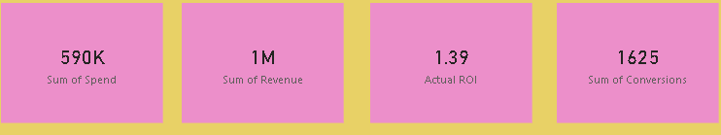
KEY KPI’S
Campaign Spend: 590K
Revenue Generated: 1M
Total Conversions: 1625
ROI: 1.39 (139%)

Slide 4
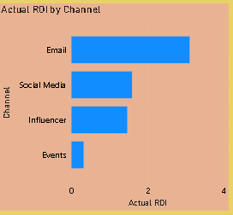
CHANNEL PERFORMANCE
Insights:
Email channel has highest ROI
Social Media performs moderately
Influencer campaigns show decent ROI
Events have lowest ROI
Conclusion:
👉 Email is the most profitable channel

Slide 5
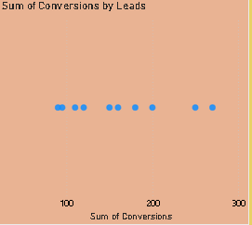
CONVERSIONS ANALYSIS
Insights:
Conversions are spread across multiple campaigns
Some campaigns generate high leads but lower conversions
Indicates possible targeting or funnel issues
Conclusion:
👉 Need to improve conversion strategy

Slide 6
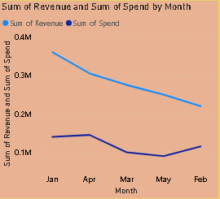
REVENUE vs SPEND TREND
Insights:
Revenue is consistently higher than spend
ROI remains positive across months
Slight decline trend in both revenue and spend
Conclusion:
👉 Marketing is profitable but needs scaling

Slide 7
KEY INSIGHTS
Email campaigns deliver highest ROI
Events campaigns are underperforming
Some campaigns generate leads but fail to convert
Overall ROI is strong (139%)

Slide 8
RECOMMENDATIONS
Increase budget for Email campaigns
Optimize Social Media targeting
Improve Influencer campaign strategy
Reduce or redesign Event campaigns
Focus on improving conversion funnel

Slide 9
FUTURE STRATEGY
Allocate more budget to high ROI channels
Use data-driven targeting
A/B test campaigns for better performance
Track CPA and ROI regularly

